Slide 1
Team 2 - Deployment Project
Collaborative Working Between:
Louy Heidar
Jack Murphy
David Murdoch
Bradley Pollard
Azim Malik
Notes:
Hello, this is a presentation for Team 2’s including Jack, Bradley, Azim, myself and our project manager Louy. Please enjoy.

Slide 2
Project Aim & Requirements
Ansible to configure Docker within AWS.
Successfully deploy Docker containers within AWS Environment.
Automate the process of setting up a Continuous Integration (CI) pipeline using Ansible.
Ensure configured platform have no issues within live operations.
Notes:
The aim of the project was to automate the process of setting up a CI pipeline using Ansible. I will define the terminology later on in the presentation.

Slide 3
Project Tools
Continuous Integration Pipeline (Tool Category) | Selected Application
CI Tool | Jenkins
Code Review Tool | Git
Build Management Tool | Maven
Monitoring Tool | Zabbix
Artifact Repository | Nexus
Project Tracker | Jira

Slide 4
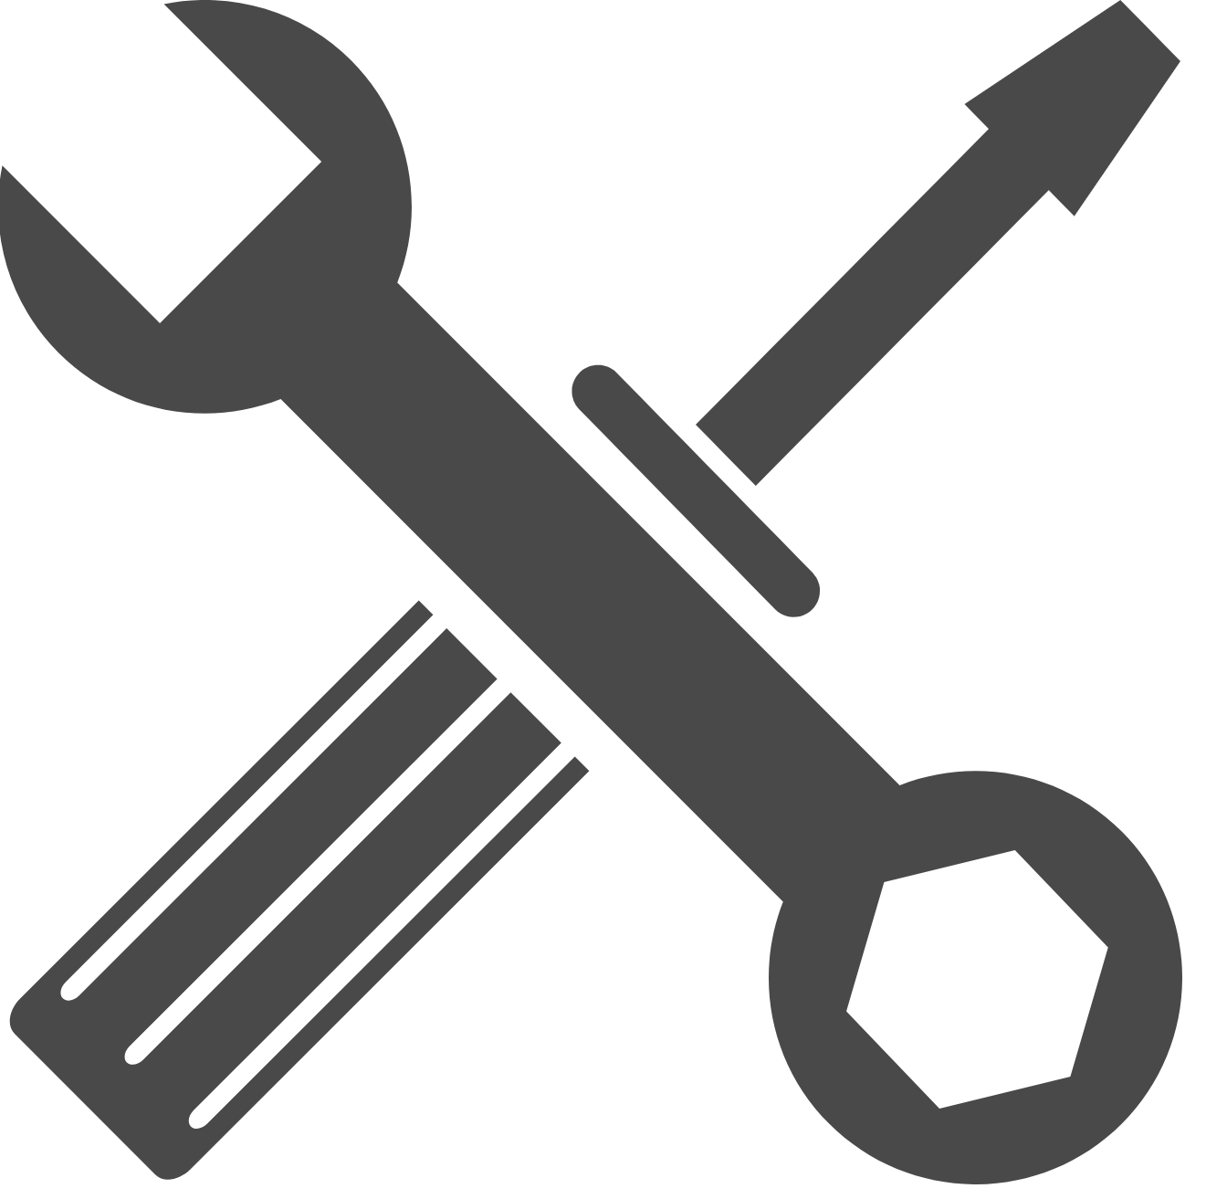

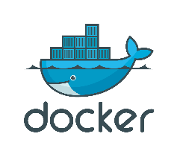
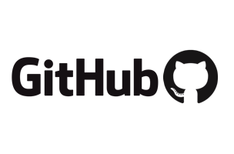




Other Tools Used
Deployment
Setup
Ansible
Docker
Apache Tomcat
Amazon AWS
Slack
Trello
GitHub
Notes:
This is a list of the tools used in this project. They have been separated (for the most part) into the tools involved in the pipeline

Slide 5
Setup Tools

Slide 6
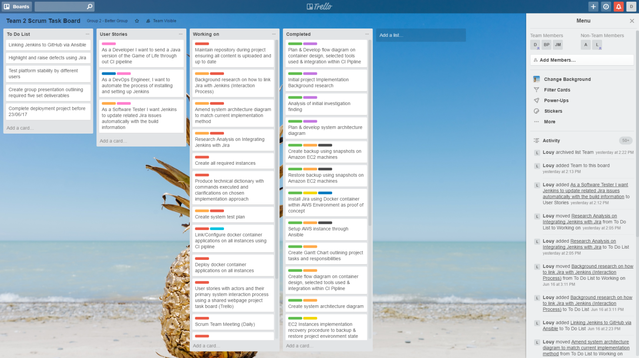
Trello
Atlassian Product
Task Manager

Slide 7
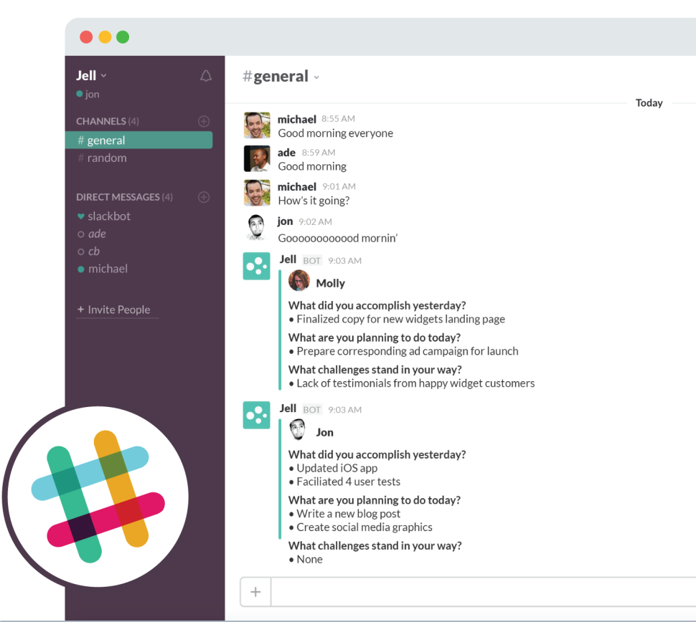
Slack
Messaging app
Separate workforce into groups
File and Image sharing
Direct messaging between workers
Integration of other Apps (including Trello)
Notification Support

Slide 8
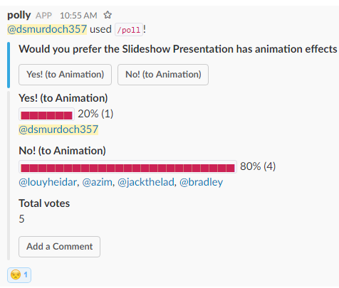
Slack Polly
Notes:
Scalability

Slide 9
Git/GitHub
Git is a Version Control Tool
GitHub is a Repository Tool integrated with Git
sudo apt install git (for Debian-based distros)
Merged Repository for this Project: https://github.com/JMurph9/Team2CIProject

Slide 10
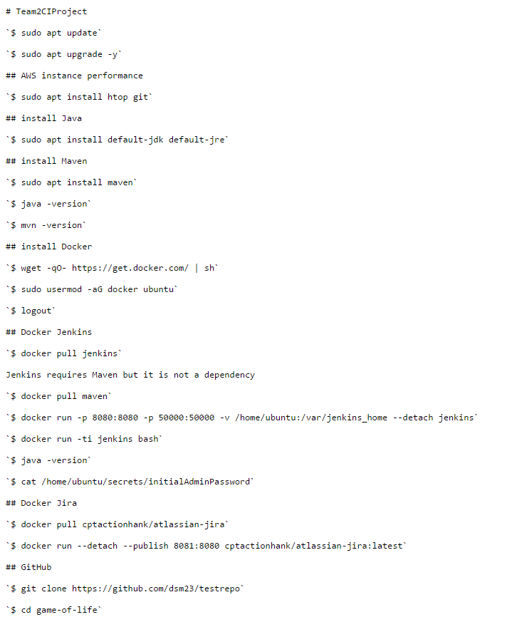
GitHub Page
README.md
Merged Repository for this Project: https://github.com/JMurph9/Team2CIProject

Slide 11
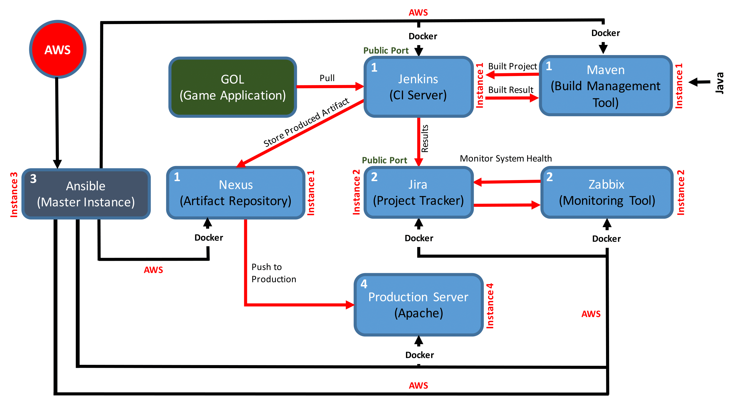
CI Pipeline
Git
Jenkins
Jira
Tomcat
Zabbix
Nexus
Maven

Slide 12
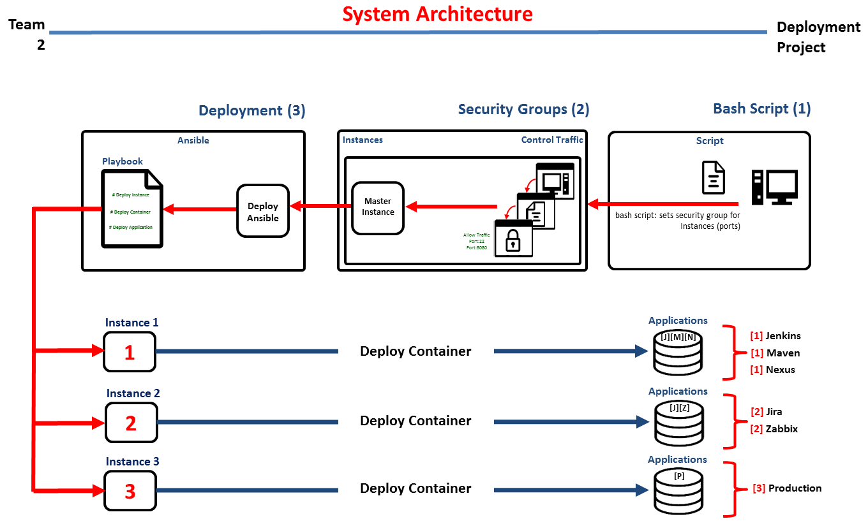
CI Architecture
Git
Docker
Jenkins
Jira
Tomcat
Zabbix
Nexus
Maven

Slide 13
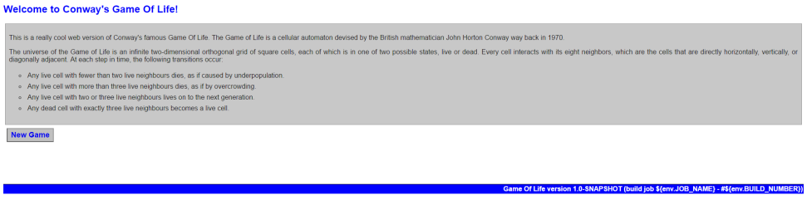
Desired Result/Game of Life
Java web servlet
Requires building before running
Contains acceptance tests
Can flow through the pipeline

Slide 14
Automated Tools

Slide 15
Maven
Build automation tool
Dynamically downloads Java libraries during compilation stage
mvn install

Slide 16
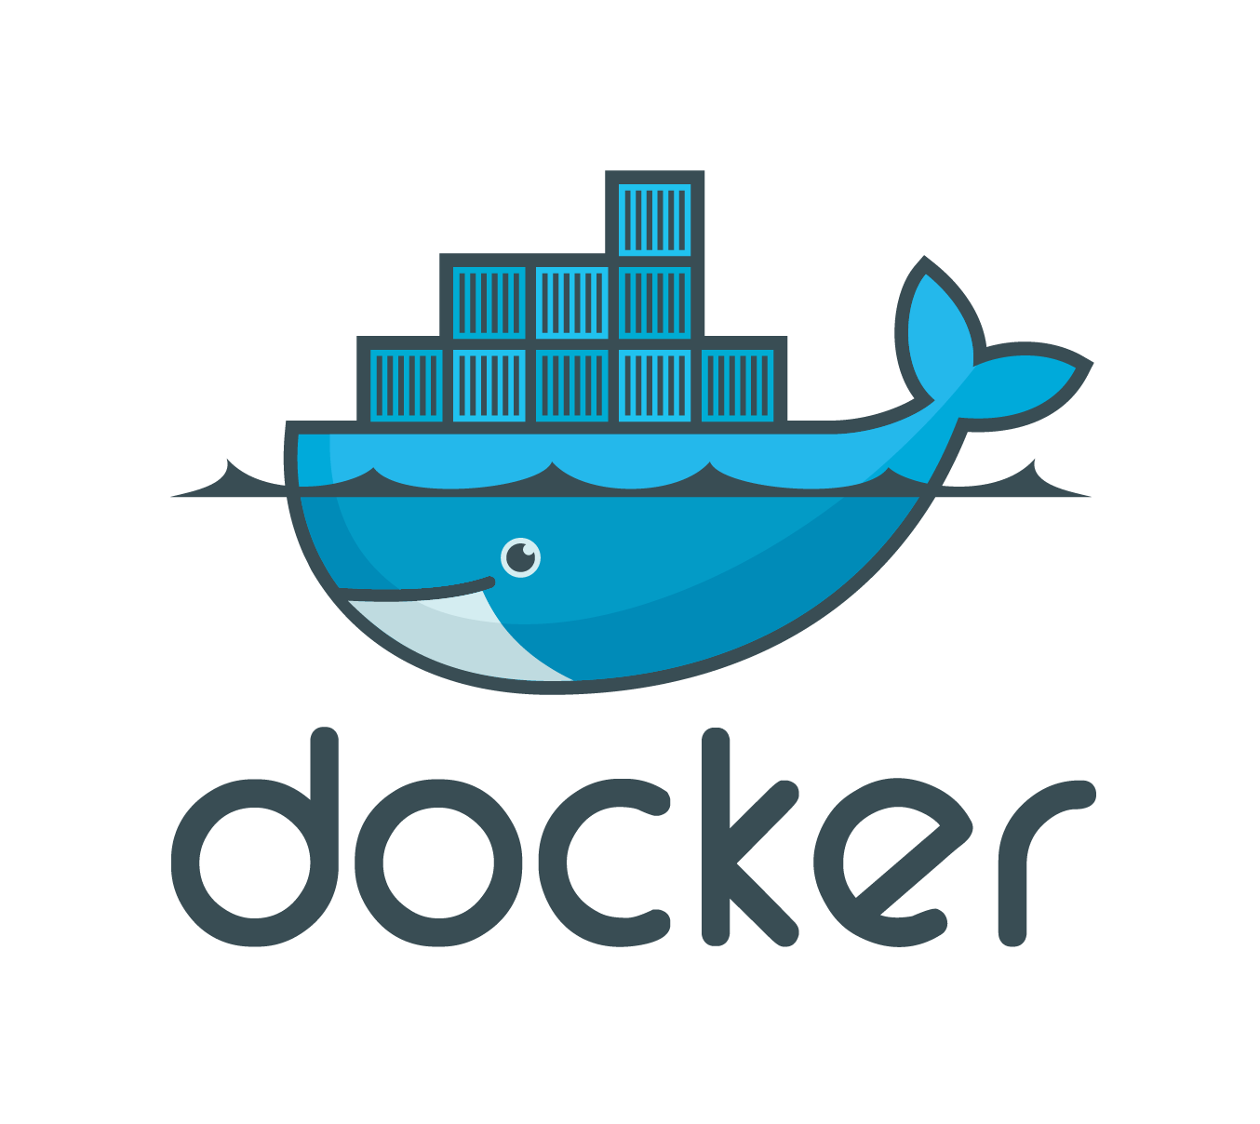
Docker
Docker Hub Repository
Docker pulls dependencies
Logout of instance
sudo service docker restart
docker pull jenkins

Slide 17
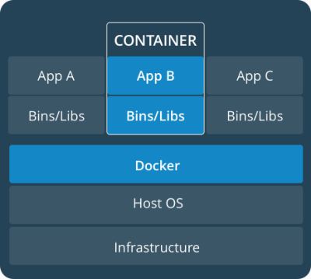
Docker Containers

Slide 18
Cloud Computing
What is Cloud Computing?
A meaningless buzzword
A remote server hosted in an external location
Infrastructure

Slide 19
Amazon AWS
Instances with easily variable RAM
Have a higher upload and download rate than our desktop computers
1 Master instance and 3 Master instances

Slide 20
Java
Object-Orientated Compiler Programming Language
All Tools used in this Project require Java as a dependency
Notes:
Every Tool that we pull from docker has Java as a dependency

Slide 21
Ansible
Provisioning Tool
Create and use slaves from a master
Can setup all other tools involved in the pipeline
Uses .yml files

Slide 22
Jenkins
Functions
Problems
Builds pipeline
Maven added as a plugin
Docker version is not dependent on Maven
Notes:
Docker version is not dependent on Maven

Slide 23
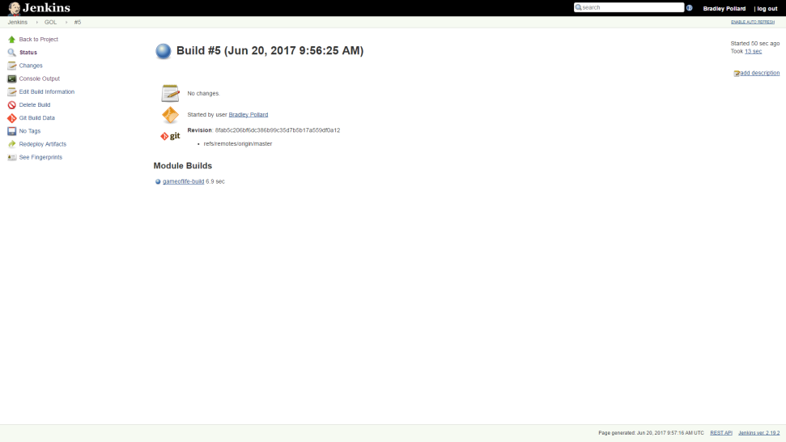

Slide 24
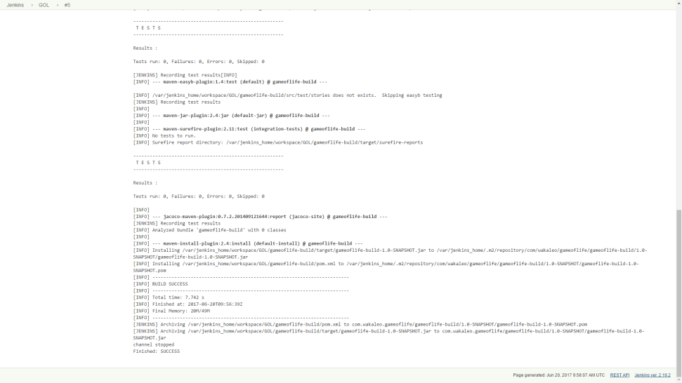

Slide 25
Jira
Atlassian Product
Project Tracker

Slide 26
Tomcat
Apache product
Used for deployment

Slide 27
Nexus
Artifact Tool

Slide 28
Zabbix
Monitoring Tool
No GUI

Slide 29
Project Method

Slide 30
How we completed the project
Gantt Chart
Top-Down, Sequential Approach to Ansible script
Scrum meetings in the mornings. Did not include user story analysis
Having different parts of the pipeline across different instances requires ssh-ing between them

Slide 31
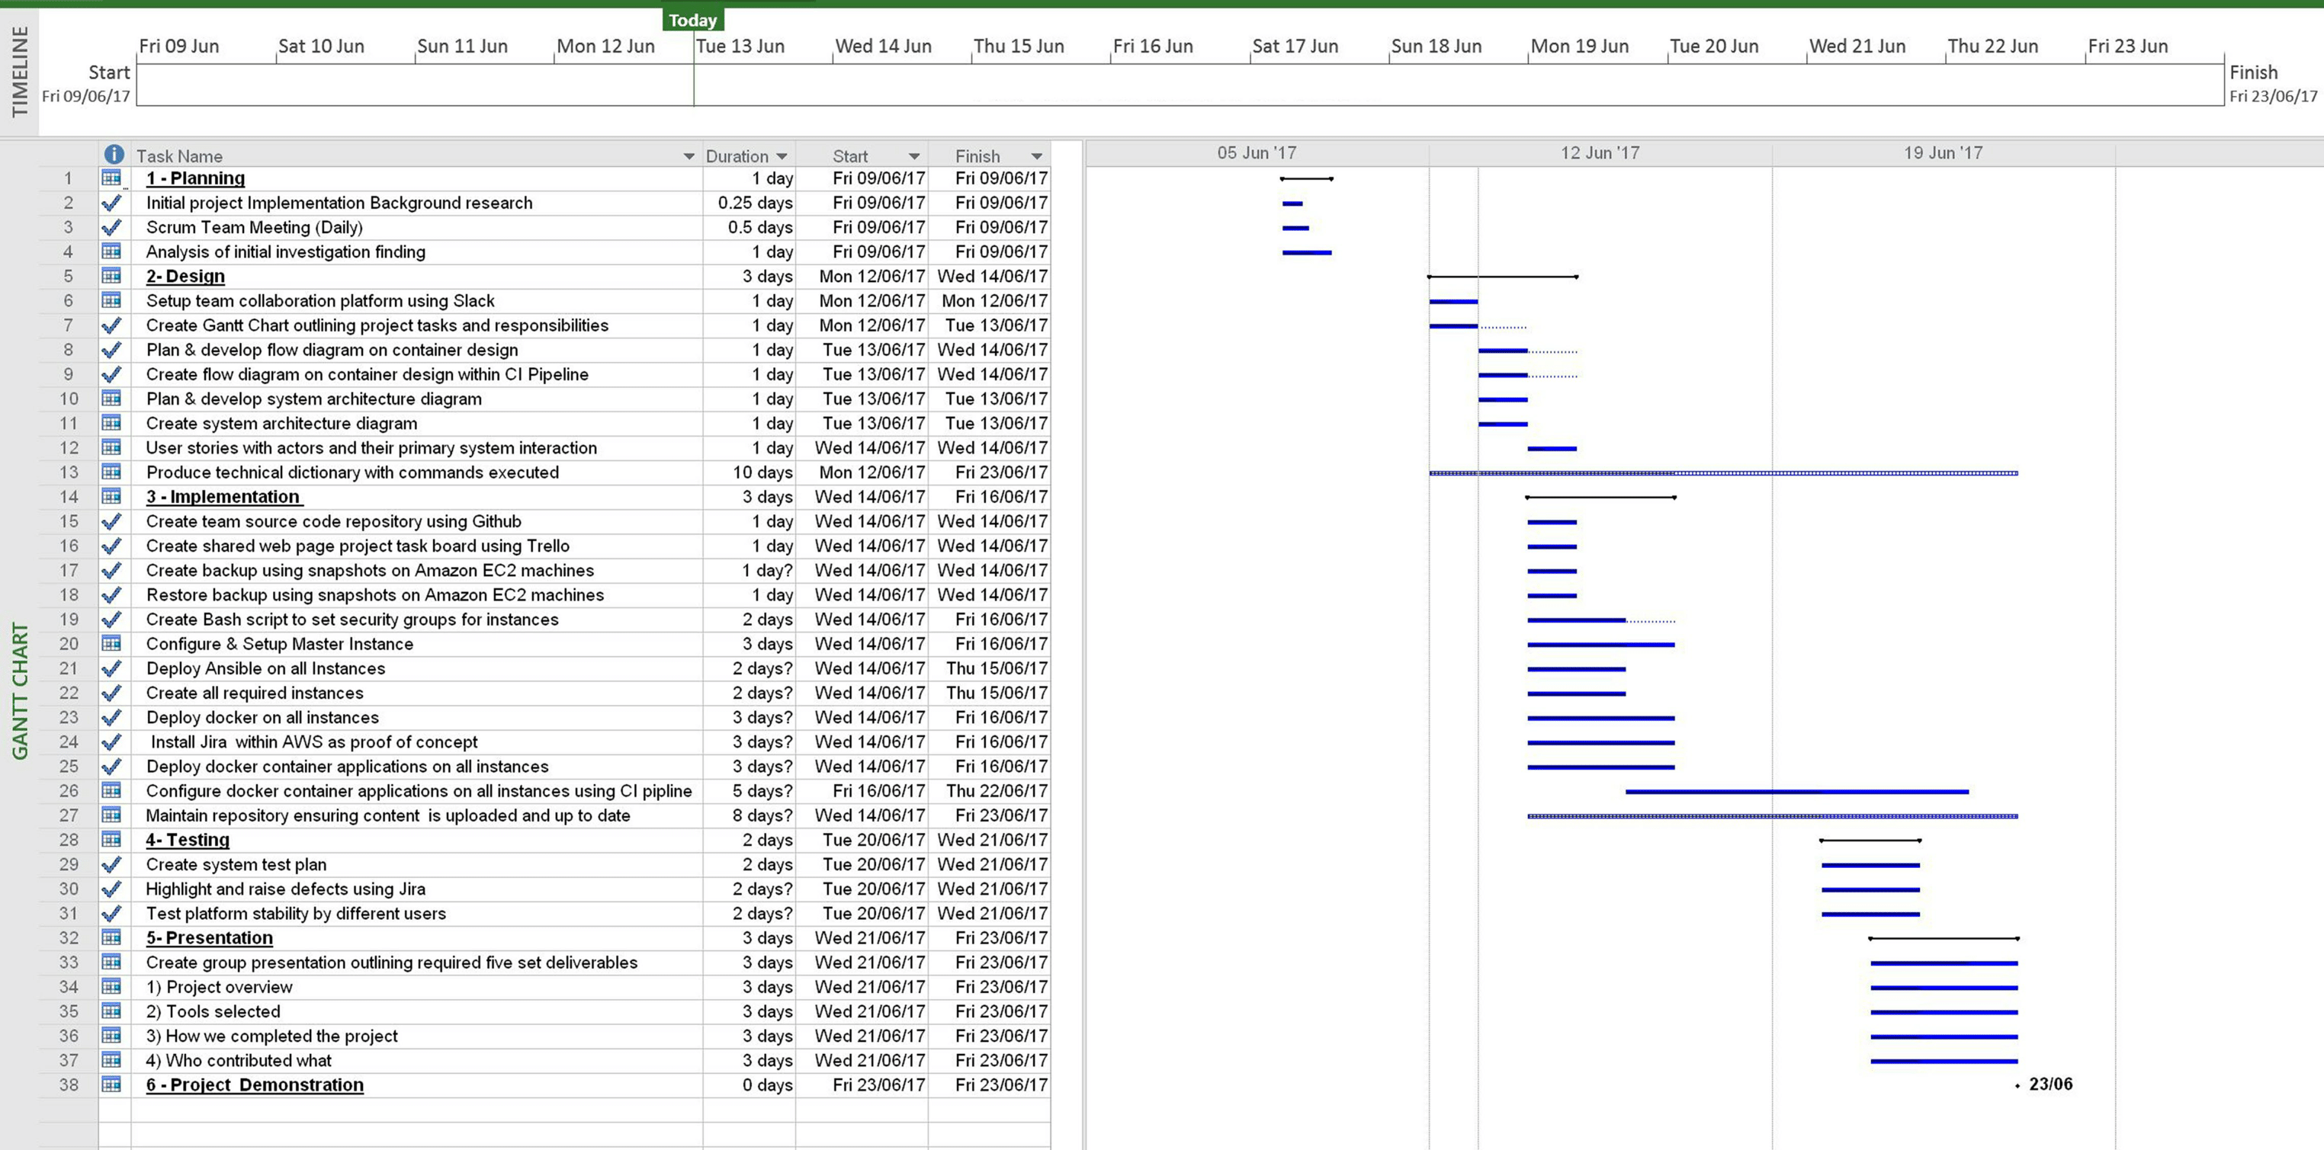
Gantt Chart

Slide 32
Who contributed what
Project Member | Delegated work
Louy | Produced the Gantt Chart. Lead SCRUM meetings. Made all diagrams. Worked with Bradley on Ansible script
Jack | Lead research, installed Nexus and Jira
David | Setup Slack, made presentation. Attempted a bottom-up approach
Bradley | Wrote the bulk of the Ansible script
Azim | Worked on linking containers and how Jenkins and Maven build together

Slide 33
Conclusion
Summarise what went well, what did not, what you’d do the next time.
The correct etiquette for a SCRUM meeting.
Makes me re-think Puppet Quest

Slide 34
Any Questions?
Notes:
Thank you for listening. Are there any questions?

Slide 35








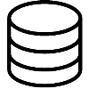
System Architecture
Team
2
Deployment Project
Deployment (3)
Security Groups (2)
Bash Script (1)
Ansible
Instances
Control Traffic
Script
Playbook
# Deploy Instance
# Deploy Container
# Deploy Application
Deploy Ansible
Master Instance
bash script: sets security group for Instances (ports)
Allow Traffic Port:22 Port:8080
Instance 1
Applications
1
Deploy Container
[J][M][N]
[1] Jenkins
[1] Maven
[1] Nexus
Instance 2
Applications
2
Deploy Container
[J][Z]
[2] Jira
[2] Zabbix
Instance 3
Applications
3
Deploy Container
[P]
[3] Production

Slide 36
David’s First Day
Setup Vagrant
Setup Game of Life
sudo dpkg -i jenkins.deb
export PATH=/opt/apache-maven-3.3.9/bin:$PATH
Requires jre:
sudo apt install default-jre
sudo apt install default-jdk
git clone https://github.com/wakaleo/game-of-life
mvn install
mvn jetty:run within gameoflife-web directory
http://localhost:9090

Slide 37
Docker
Setup
wget -qO- https://get.docker.com/ | sh
sudo usermod -aG docker ubuntu
Logout of instance
sudo service docker restart
docker pull jenkins

Slide 38
Useful Links
https://maven.apache.org/install.html
https://github.com/wakaleo/game-of-life
https://github.com/ansible/ansible-examples

